Slide 1
PA3 - Project
MNIST classification
ZHAI Guanxun
54345382

Slide 2
Part I – Pre_Process
NORMALIZATION Situation Range of grey scale value[0, 255] Problem Original classification result is wrong Solution Need to be normalized to [0, 1]

Slide 3
Part I – Pre_Process
MEAN-SUBTRACT Situation Subtract mean to simplify Problem Just use the original 2000 pictures without choosing. Solution 1. Also by dimensions 2. Mean of all the pictures for the same digits

Slide 4
Part I – Pre_Process
PCA How is the PCA results? Eigenvalue range 5~1.5-e34 How to choose no. of dimensions a. Select dimension by mean of eigenvalues (87 trail 1,86 trail 2) b. Set specified value Question Assign efficient generated by train sets on test sets

Slide 5
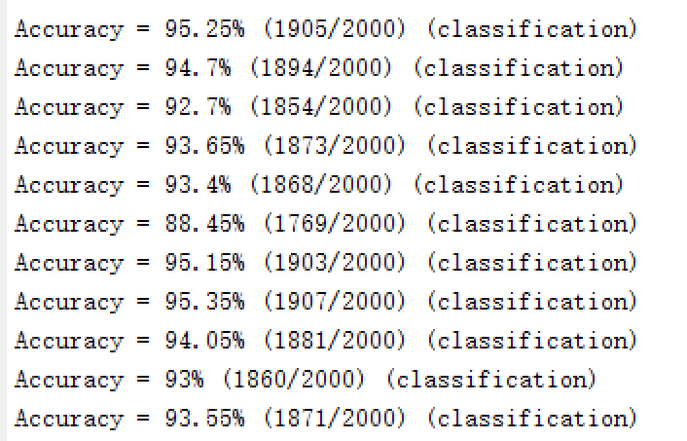
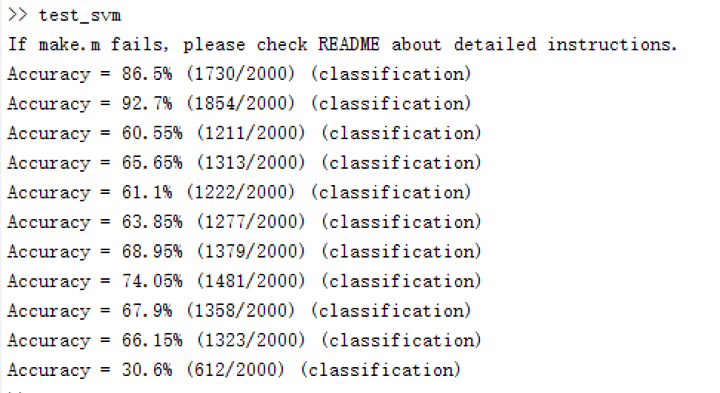
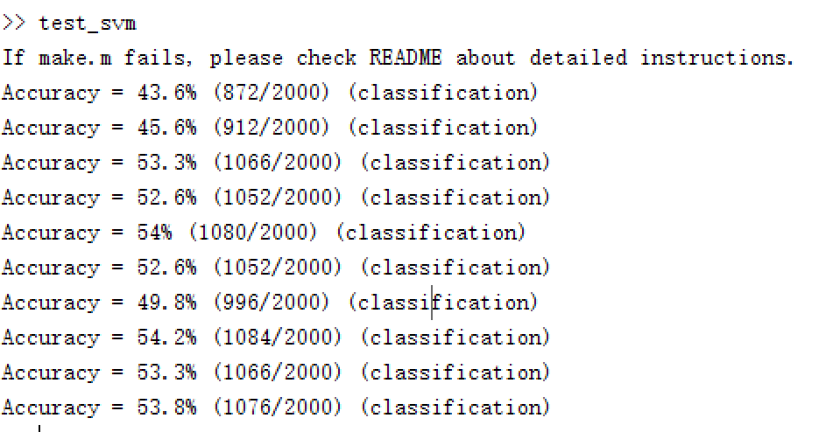
Part II - Algorithm
Final result
SVM PCA with SVM Pictures needed Two kinds of classifiers Integrated label 10-class: 93.55% 10 1-class: 81.95% (Total) The Cross Validation of SVM is: 10-class C-SVM: 93.3% 10 1-class SVM: 40% ~ 50%
PCA to 1-dim
2000 pictures

Slide 6
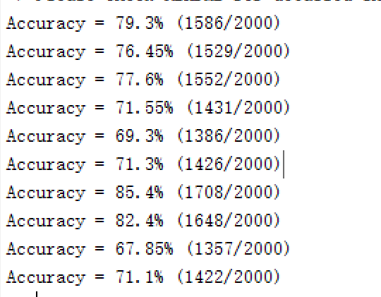
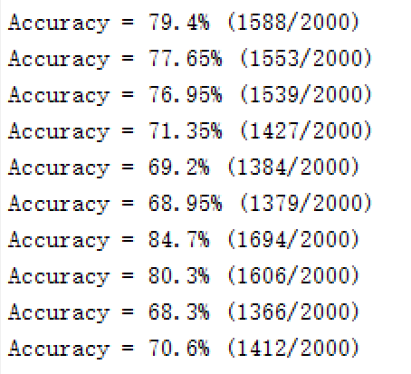
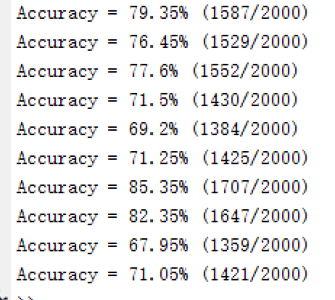
Part II - Algorithm
10 1 – class Classifier
Integrated: 79.91%
L2 - Primal
Logistic Regression Mainly for large quantity of data Sparse Matrix 3 Choices L2 Logistic Regression (Primal): 81.25%(10-class) Cross Validation (10 trails): 83.4% L1 Logistic Regression: 79.95%(10-class) Cross Validation (10 trails): 81.85% L2 Logistic Regression (dual): 80%(10-class) Cross Validation (10 trails): 81.6%
10 1 – class Classifier
Integrated: 81.25%
L1
10 1 – class Classifier
Integrated: 80.10%
L2 - Dual

Slide 7
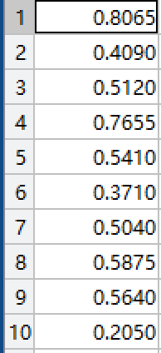
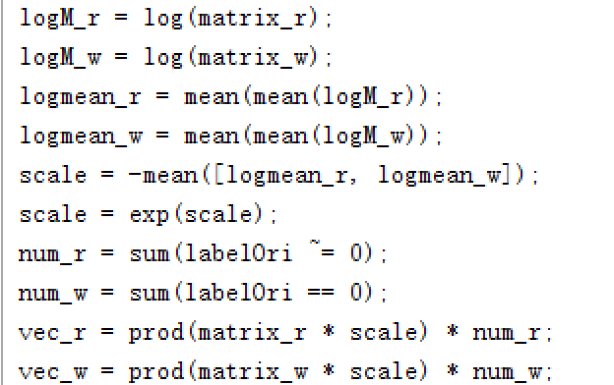
Part II - Algorithm
Naïve Bayesian Classifier 1-class classifier Based on Bayesian Statistics Four return classifier (mean, var, label, class identifier) Precision problem With or without PCA
Accuracy of 10 1 – class classifiers
Algorithm to solve
precision problem

Slide 8
Thanks For Listening
What to improve More test on Logistic Regression Fix the algorithm of the Naïve Bayesian Classifier Change the value of the SVM to get better accuracy

